Slide 1


Slide 2
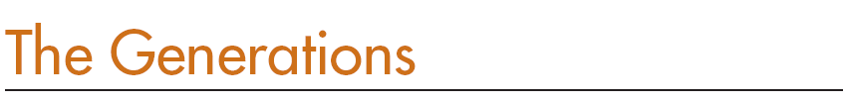
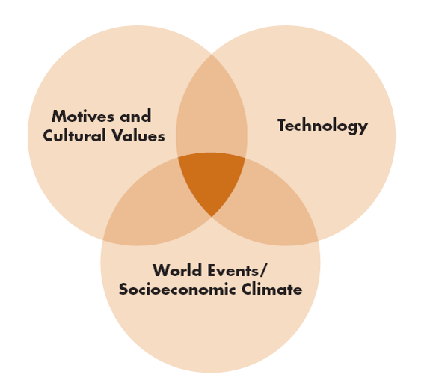

Slide 3
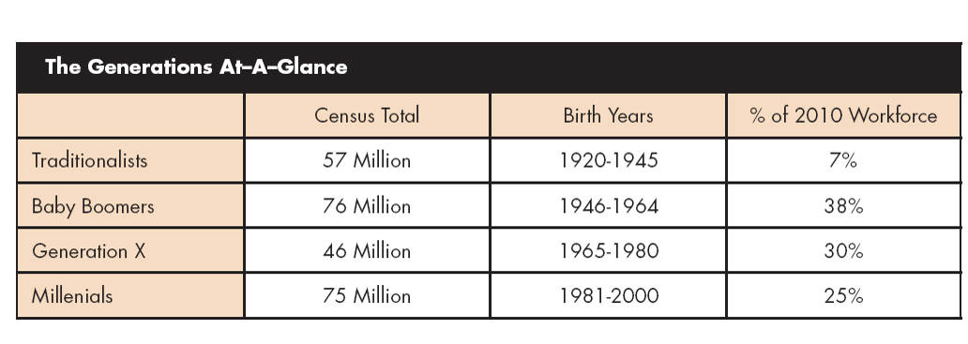

Slide 4
Generational Portrait Questions
In your most formative years (10 to 20 years old), what were the major events in the world around you?
2. How easy/hard was it for you to get your first real job—how much competition was there, and how realistic was the expectation you would be able—eventually—to do better than your parents?
3. Who were the leaders you most remember, and who were your heroes?

Slide 5
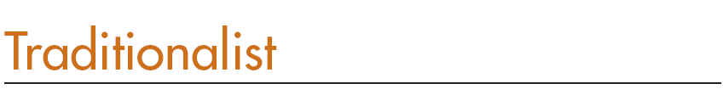

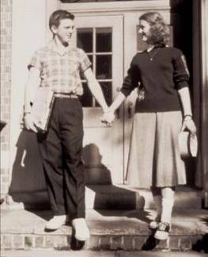
Civic pride, loyalty, respect
Gray flannel suit crowd
Institutional loyalty
White, male, seniority driven
Mixing of generations rare
Influenced by protocol and formality

Slide 6
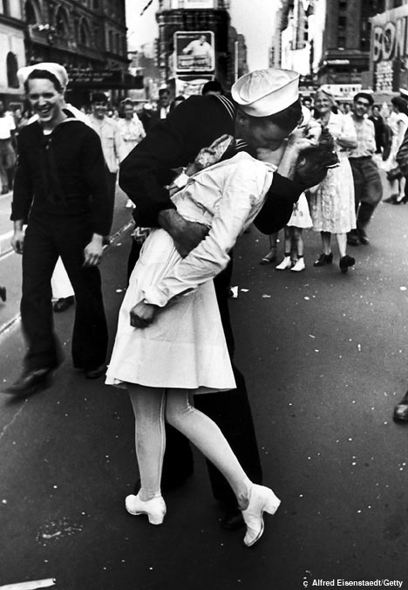
Character Shaping Events
Great Depression
Dust Bowl
President FDR
New Deal
Golden age of radio and Hollywood
Pearl Harbor and World War II
D-Day
Death of FDR
Hiroshima, Nagasaki
Birth of Nuclear Age
American grit/power win World War II
G.I. Bill

Slide 7

Music
Listened to radio
Attended concerts / dance halls to hear music
78 (rpm) albums replaced with vinyl LPs (long playing albums)
  Whole symphony could be recorded
  Record players were expensive
  Not found in every home
Popular: Big Band, Jazz, show tunes, Country-Western, Rhythm & Blues

Slide 8
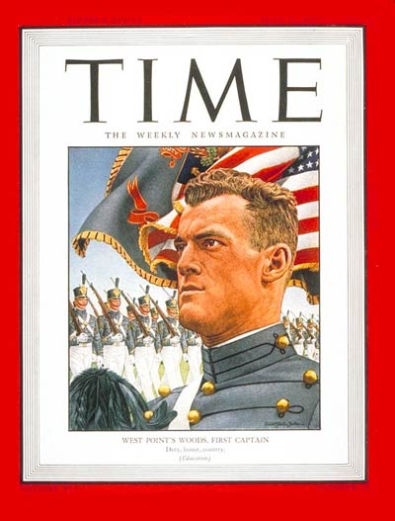

Slide 9
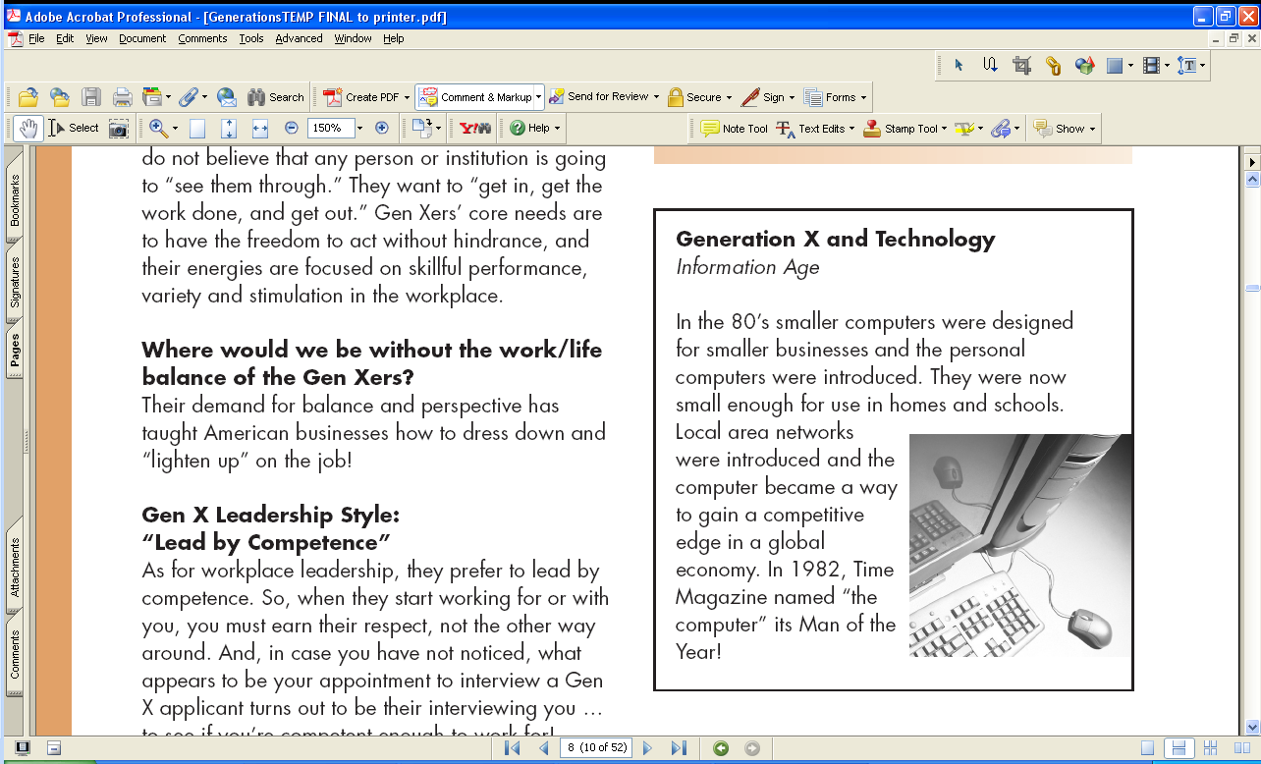
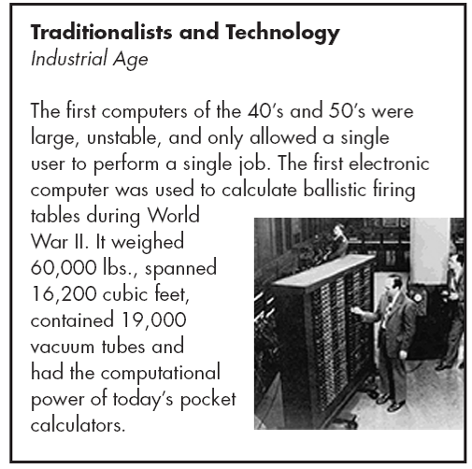

Slide 10
Action questions

Slide 11
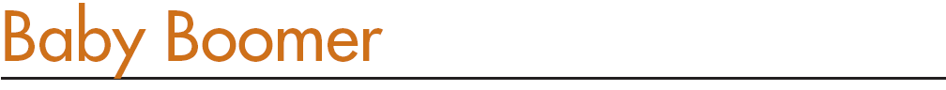

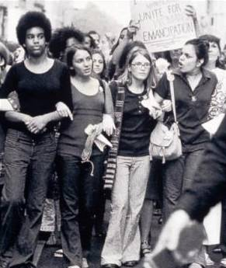
Yuppies, Boomers
End of rural, agrarian lifestyle
A baby born every 10 seconds for 20 years
Child rearing - hobby and a pleasure
Confident, expectant generation
Redefining period between mid-life and old age

Slide 12
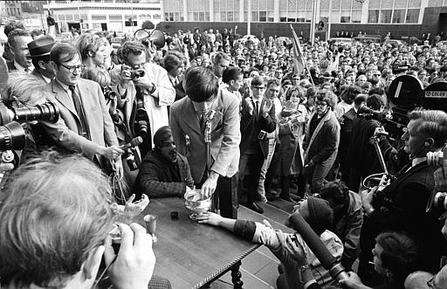
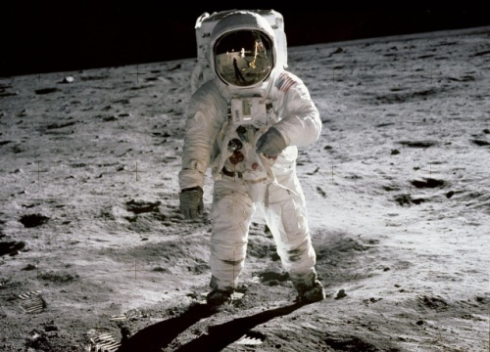
Character Shaping Events
Marshall Plan
Korean War
Red Scare
McCarthy Hearings
Sputnik
Cold War
Kennedys & Camelot
Civil Rights Movement
Vietnam
Kent State
Protests and marches
JFK, RFK & King assassinations
Feminist movement
Woodstock
Moon landing

Slide 13
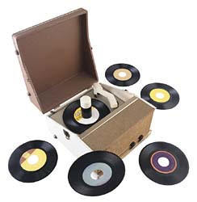
Music
Listened to radio more than any generation
  Music and dancing became generational touchstones
Record players more common as 45 (rpm) became popular
Single songs were inexpensive

Slide 14
Music
Rock-n-Roll born
  Blending Rhythm & Blues, Country-Western, Gospel
  Potent symbol of generational divide
  Cultivated throughout 50s and 60s
LP albums developed into works of art in 60s and 70s
  Explored love / life through power of music

Slide 15
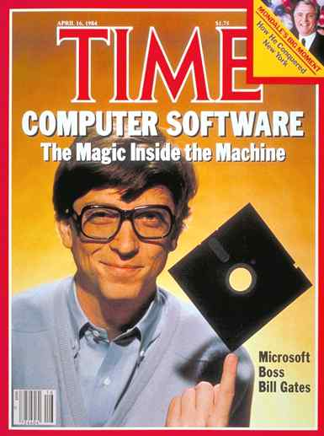

Slide 16
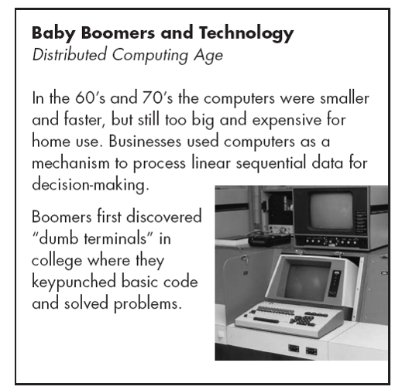

Slide 17
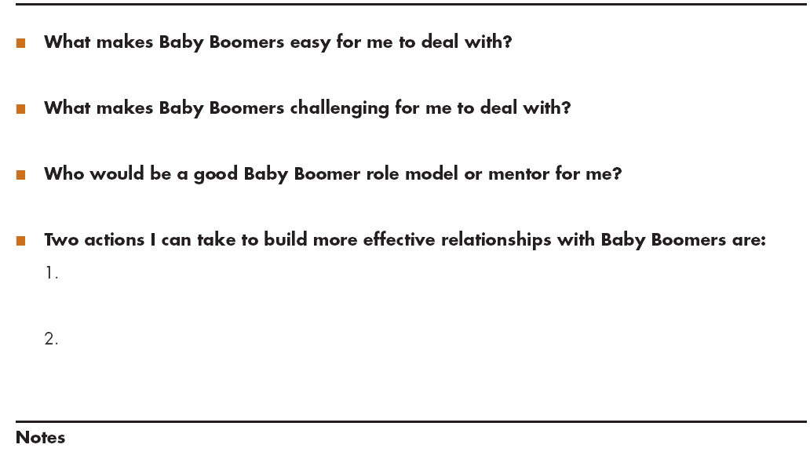
Action questions

Slide 18
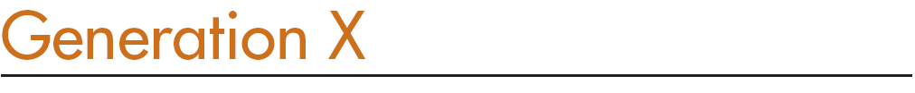
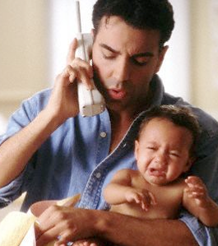
Latchkey kids
Anti-institution
Edgy skepticism
Segmented – fragmented family
“Family values” redefined
Strong entrepreneurial spirit
24/7 MTV

Slide 19
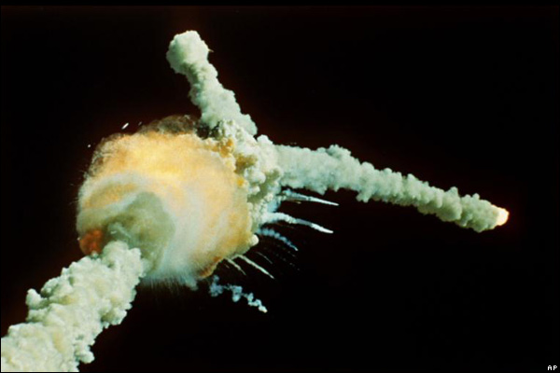
Character Shaping Events
Oil Embargo
Watergate
Nixon resignation
Three-Mile Island
John Lennon shot
Challenger explosion
Iranian hostage crisis
Reagan election and
assassination attempt
Worst recession and job market since Great Depression
Iran-Contra scandal
Fall of Berlin Wall

Slide 20
Music
Tuned into radio
Brought music videos into vogue
“I want my MTV” - generational catch-phrase
Music more frequently on cassette tapes
Music is portable—car stereos, boom boxes, Walkman tape players
Gen Xers make music compilation tapes at home
Personalized musical statements

Slide 21
Music
Rock-n-Roll fragments
  Pop, R&B, Rap, Country, Heavy Metal and Grunge
  To name only a few …
Music becomes digital
Music moves from albums and cassettes to compact discs (CDs)

Slide 22


Slide 24
Action questions

Slide 25
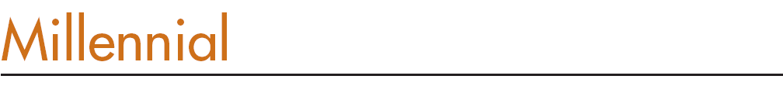


Internet generation
Most protected children
1 in 3 not Caucasian
2 in 4 live in single parent home
4 in 5 have working mothers
1/3 teens work 20+ hours a week
WORK is a four-letter word

Slide 26
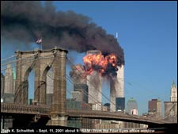
Character Shaping Events
Internet
Globalization
Columbine killings
Desert Storm
Oklahoma City Bombing
Clinton impeached
September 11, 2001
Booming economy & job market
US invades Afghanistan & Iraq
2008 World Recession
Barack Obama elected

Slide 27
Music
Music is presented, stored, sold digitally
  Allows more ways to listen to, explore, and exchange
  More ways than any previous generation
Force behind Napster and file-sharing platforms
Belief: “Electronic files—including songs—should be free for the swapping”
This attitude is driving entertainment industry to reinvent business models

Slide 28

Music
Use iPods or other players (MP3) - standard gear
Create and upload their own music
Explore web for new bands
Follow favorite groups on social networking sites and fan blogs
Download new songs and video - often for free

Slide 29
Music
Since mid 90s, music is dynamic mix of new and borrowed tunes
Mash-up of styles:
  Hip-Hip
  Rock-n-Roll
  Country
  Rhythm & Blues
  World Music
Most tuned-in generation
  Broader, diverse palette—musically and culturally

Slide 30


Slide 31
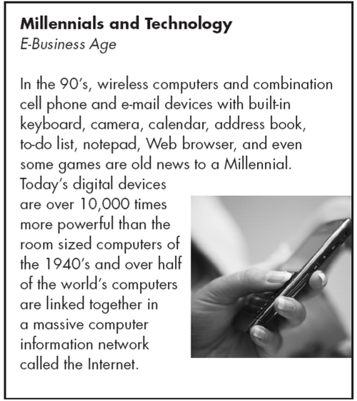

Slide 32
Action questions

Slide 33
Communication Tips
Show respect for their length of service and experience
Use more formal language
Watch your language – no cursing allowed
Take time when discussing technology
Do your homework; prepare to be tested
Respect their attention to formality
Say “thank you” and “please”
Don’t rush or pressure them
Serve and honor them

Slide 34
Communication Tips
Honor their experience
Ask for their advice
Value the “people side” of business
Speak in an open, personal style
Offer to partner and get the job done; don’t wait to be asked
Support them; make them look good
Don’t call them “older.” Use descriptors like “mature”, “experienced” or “prime”
Put a priority on a business atmosphere and the relationships formed there

Slide 35
Communication Tips
Talk with them, not to them
Listen to them. You might learn something!
Use hands-off supervision
When delegating, describe outcomes, but leave results to them
Don’t waste their time
Provide immediate answers and feedback
Value their need to keep learning in order for them to be marketable
Give them challenges, not “busy work”

Slide 36
Communication Tips
Answer their constant “why” questions or ignore them to your own peril
Give them your web address and be prepared for a website critique
Emphasize positives of doing right rather than negatives of doing wrong
Be positive, simple, rational, factual and friendly
Respond quickly - “instant gratification”
Mentor them and be realistic
Be prepared to offer flexible scheduling

Slide 37

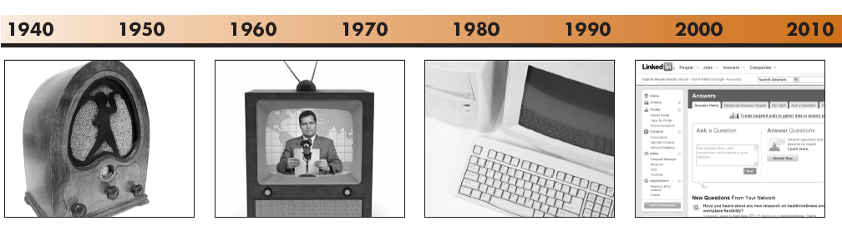

Slide 38
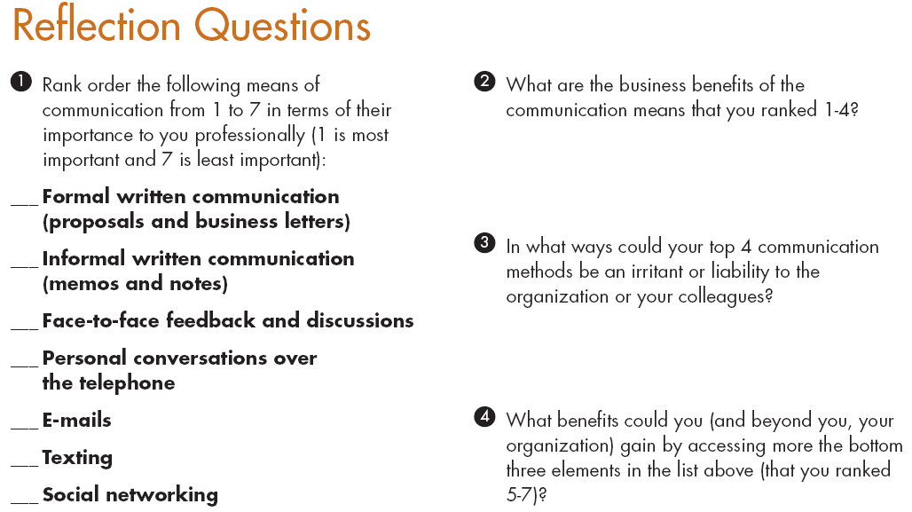

Slide 39


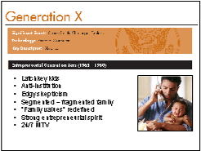
Training Program
Participant Workbook & PowerPoint slides
  Rich descriptions
  Communication tips
  Technology differences
  Individual and team exercises
  Case studies
  Resources

Slide 42
