Slide 1
Appreciative Leadership
Diana Whitney
Chesapeake Bay ODN Conference 2010
“Leading Transformation in Complex Times”

Slide 2
An Invitation to
A Positive Revolution
Appreciative Inquiry
Strengths Movement
Positive Psychology
Positive Organizational Scholarship
Asset Based Development
Positive Deviancy
Solution Based Therapy
Creation Spirituality
Notes:
Revolution in leadership and change
My personal invitation was in 1980 from a spiritual teacher who said, Diana it is time for you to “learn to live and work in the energetically positive.”
Bob Quinn, AI is changing the way we do change, it is leading a positive revolution.

Slide 3
Five Strategies of
Appreciative Leadership
The Wisdom of INQUIRY
The Genius of INCLUSION
The Art of ILLUMINATION
The Courage of INSPIRATION
The Path of INTEGRITY
Appreciative Leadership
Whitney, Trosten-Bloom, Rader

Slide 4

1. The Wisdom of Inquiry
Asking Positively Powerful Questions
“Tell me about the river that connects you.”
Appreciative Leadership
Whitney, Trosten-Bloom, Rader
Notes:
Practice – Asking Value Based Questions, Choose the Topic of your questions, Put your values in your questions. Brian’s Story
Or The River that Connects Us.

Slide 5
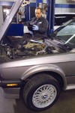
The Case of BP PROCARE
Survey Results showed 79% Customer Satisfaction
  Desired to improve
  Conducted Focus Groups
    Dissatisfied Customers
    Asked: What are we doing wrong?
  Shared the information widely
  The bottom drops out...

Slide 6

The Appreciative Alternative
A Root Cause of Success Analysis
Study of Outstanding Customer Satisfaction
  Interviews with All Customers
    What attracted you to us initially?
    Your best experience with us?
    What made it satisfying?
  Generative Benchmarking
  8 months - 95% Fully Satisfied
  What did they learn?

Slide 7

What is Appreciative Inquiry?
The study of what gives life to human systems – people, teams, organizations, processes – when they are at our best.
  Appreciation = valuing, prizing, affirming, honoring, recognizing the best of people and situations.
  Inquiry = exploration, discovery, asking, being open to seeing new potential and possibilities.

Slide 8
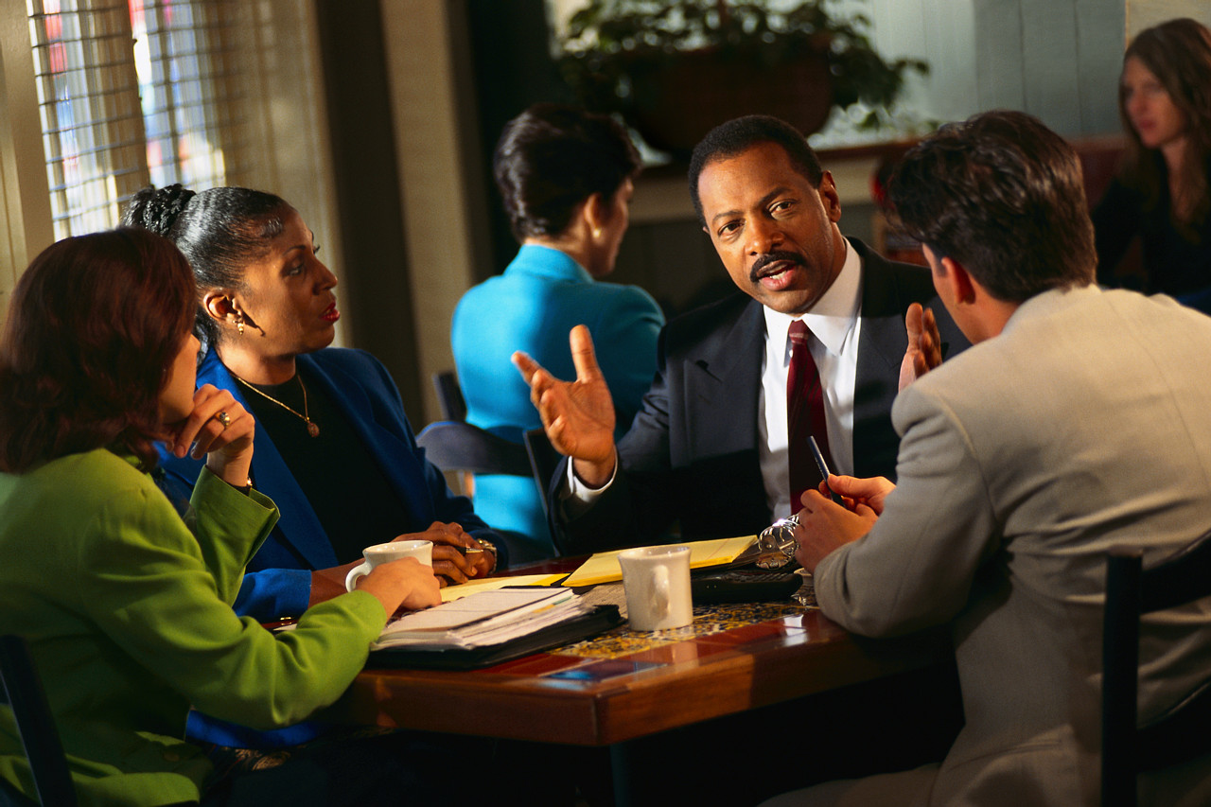
Appreciative Inquiry
An Alternative to Problem Solving

Slide 9
Unintended Consequences
Deficit Approaches to Change
Slow: Puts attention on yesterday’s causes
Produces “vocabularies of human deficit”
Downward spirals of energy and morale > fatigue
Weakened teamwork & relationships

Slide 10
Inquiry is the Intervention
The questions we ask are fateful.
They determine what we find.
They create the world as we know it.

Slide 11
What We Study Matters
It sets the agenda for dialogue, learning and change.
Stress at Work
Joyful Productivity

Slide 12

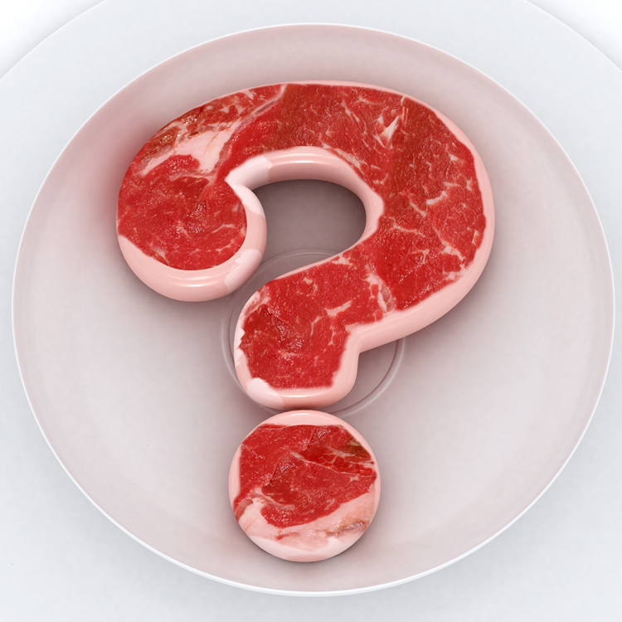
Put your values in your questions.
Appreciative Leadership Practice
Notes:
Dorrie’s question – How do I transform my workforce from fear to courage? Study courage, risk taking..
Brian’s story

Slide 13
Social Construction Theory
Meaning is made in relationship.
    Conversation, language, words and stories are our vehicles – for making meaning and creating realities.
Human organizing is conversational.
    “Organization culture is the story we tell ourselves about ourselves and then we forget it’s just a story.”
    We are constantly analyzing, interpreting, making sense and creating realities together.
To change organizations is to change the conversation – who talks to whom about what.
Notes:
UVA story of meeting with Dean and then debriefing and debriefing and debriefing….4 times.
Pope and Rabbi story

Slide 14
2.The Genius of Inclusion
Engaging With People to Co-Create the Future
All the people who’s future it is need to be in the conversation about the future.
People commit to what they help create.
Appreciative Leadership
Whitney, Trosten-Bloom, Rader
Notes:
Idaho State Department of Education – Services for Students who are Deaf and Blind
George’s story.

Slide 15
Inquiry Among Improbable Pairs.
Appreciative Leadership Practice
Notes:
Idaho State Dept of Education – George’s Story

Slide 16
3. The Art of Illumination
Bringing Out the Best of People and Situations
Appreciative Leadership
Whitney, Trosten-Bloom, Rader
Notes:
Practice – Strengths spotting, alignment, developing in areas of strengths

Slide 17
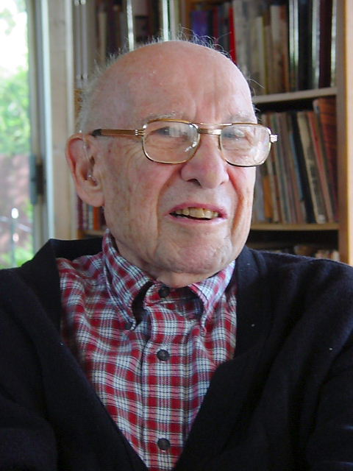
Peter Drucker
The task of leadership is to create an alignment of strengths – for a purpose or toward a goal – in such a way that weaknesses become irrelevant.

Slide 18

Strengths
“Near perfect performance in an activity.”
    Feel easy.
    Increase excellence, success, productivity.
    Provide a sense of joy, flow, energy, and fulfillment.
      Now, Discover Your Strengths
      Buckingham and Clifton
Notes:
The StrengthsFinder™ instrument was developed over 30 years by interviewing more than 2 million people from all walks of life (e.g., teachers, managers, doctors, athletes, stockbrokers, accountants, housekeepers, soldiers, nurses, pastors, CEOs). From these interviews they developed 34 strengths.
Are made up of Talents, knowledge and skills.

Slide 19
Excellent Performers
Are rarely well-rounded.
They capitalize on their strengths.
They minimize their weaknesses.
Each person’s greatest room for growth is in his or her areas of greatest strengths.
      Now, Discover Your Strengths
      Buckingham and Clifton
Notes:
What percentage of a typical day do you spend playing to your strengths?”
17% of people say most of the time
That’s less than 2 out of 10 people!

Slide 20

Be a Strengths Spotter.
Appreciative Leadership Practice
Notes:
Dorrie’s question – How do I transform my workforce from fear to courage? Study courage, risk taking..
Brian’s story

Slide 21
Strengths Spotting Inquiry
Tell me about a recent success, something you’ve done in the past few weeks or months that gave you great satisfaction and pride.
      What did you do?
      What else did you do?
      What gave you the idea to do this?
      Who else was involved and how did you relate to them?
      Tell me more about what you did to make this a success.
Based upon your success story, I sense that some of your strengths are…

Slide 22
Strengths Spotting – Try it Now
Select a partner – someone new.
Ask your partner to tell you a success story.
Listen to discover your partner’s strengths.
Reflect the strengths back to your partner
Reverse Roles
Total Time 8 minutes – 4 minutes each

Slide 23
4. The Courage of Inspiration
Awakening the Creative Spirit
All change requires large amounts of positive emotions, energy, enthusiasm.
Hope – belief in the best in the midst of the worst.
Appreciative Leadership
Whitney, Trosten-Bloom, Rader
Notes:
Hope: Believing in the Best in the Midst of the Worst
Vision and Path Forward
Hope –connects one happily to the future
Zest –reside in the here and now
Gratitude –connects one happily to the past

Slide 24

The Birth of Positive Psychology
Prof. Martin Seligman, President, APA, 1996
Author: Learned Optimism; Authentic Happiness
        30 years of psychology research
          45,000 studies on depression, illness
          300 studies on joy, hope, happiness

Slide 25
Research on Positive Emotions
Prof. Barbara Fredrickson, UNC
Author: Positivity
Broaden and Build Theory
        Positive Emotions:
  Broaden Attention and Thinking
  Undo Lingering Negative Emotional Arousal
  Build Resilient Coping…Like Immune System

Slide 26
Positive Emotions & Performance
Joy………...play, imagination, experimentation →innovation
Interest…..involvement, investigate, explore →new knowledge
Optimism...opportunity, confidence, persevere →achievement
Contentment…savor, integrate complex ideas →deeper insight
Love…………….…………………connect, relate →cooperation

Slide 27
“Positivity Ratio” and Performance
People flourish in the presence of positive emotions and communication.
The Healthy Range is 4+ : 1- ------------- 11+ : 1-
Marcial Losada, Chile
Successful Teams 5+:1-
John Gottman, UC Berkley
Long Term Successful Marriages 5+:1-
Notes:
Less than 4+ to 1- people tend to have low self confidence, be fearful, and constricted. They are less than they can be.
Over 11+ to 1- people tend not to believe what they hear. It seems unrealistic.

Slide 28

Practice a 5+/1- Positivity Ratio.
Appreciative Leadership Practice
Notes:
Dorrie’s question – How do I transform my workforce from fear to courage? Study courage, risk taking..
Brian’s story

Slide 29
Appreciative Leadership
The relational capacity to mobilize creative potential and turn it into positive power—to set in motion positive ripples of confidence, energy, enthusiasm, and performance—to make a positive difference in the world.
Appreciative Leadership
Whitney, Trosten-Bloom, Rader

Slide 30

5. The Path of Integrity
Making Choices for the Good of the Whole
Starts with You – Your Own Wholeness
Appreciative Leadership
Whitney, Trosten-Bloom, Rader
Notes:
Integrity, Integral, Wholeness
Triple Bottom Line: People, Profit and Planet
“I ratted on myself”

Slide 31
To Thy Own Strengths Be True.
Appreciative Leadership Practice

Slide 32
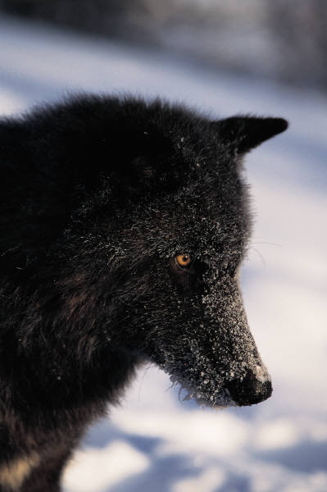
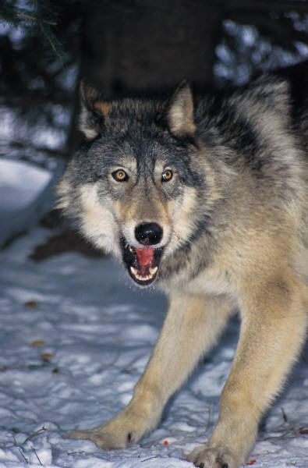
A Tale of Two Wolves

Slide 33

Practices for Feeding The Positive and Leading Transformation in Complex Times
Focus on Root Causes of Success. Let Weaknesses be Irrelevant.
Ask Appreciative Questions.
Practice a 5/1 “Positivity Ratio.”
Be a “Strengths Spotter.”
Take Care of Yourself. So You Can Take Care of Others.

Slide 34
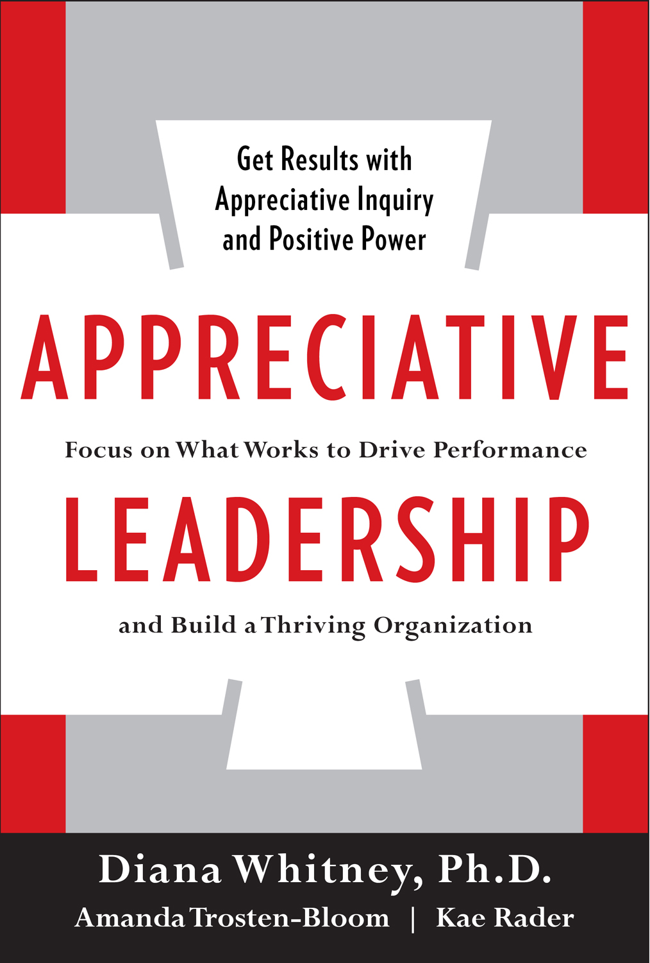
For More Information
Available July, 2010
The Power of Appreciative Inquiry
Whitney & Trosten-Bloom
Diana Whitney
diana@positivechange.org
Corporation for Positive Change
www.positivechange.org

